Slide 1

Building Afrocentric AI Models
Dr Michael S. Mollel (PhD)
Co-Founder & CEO Sartify LLC

Slide 2
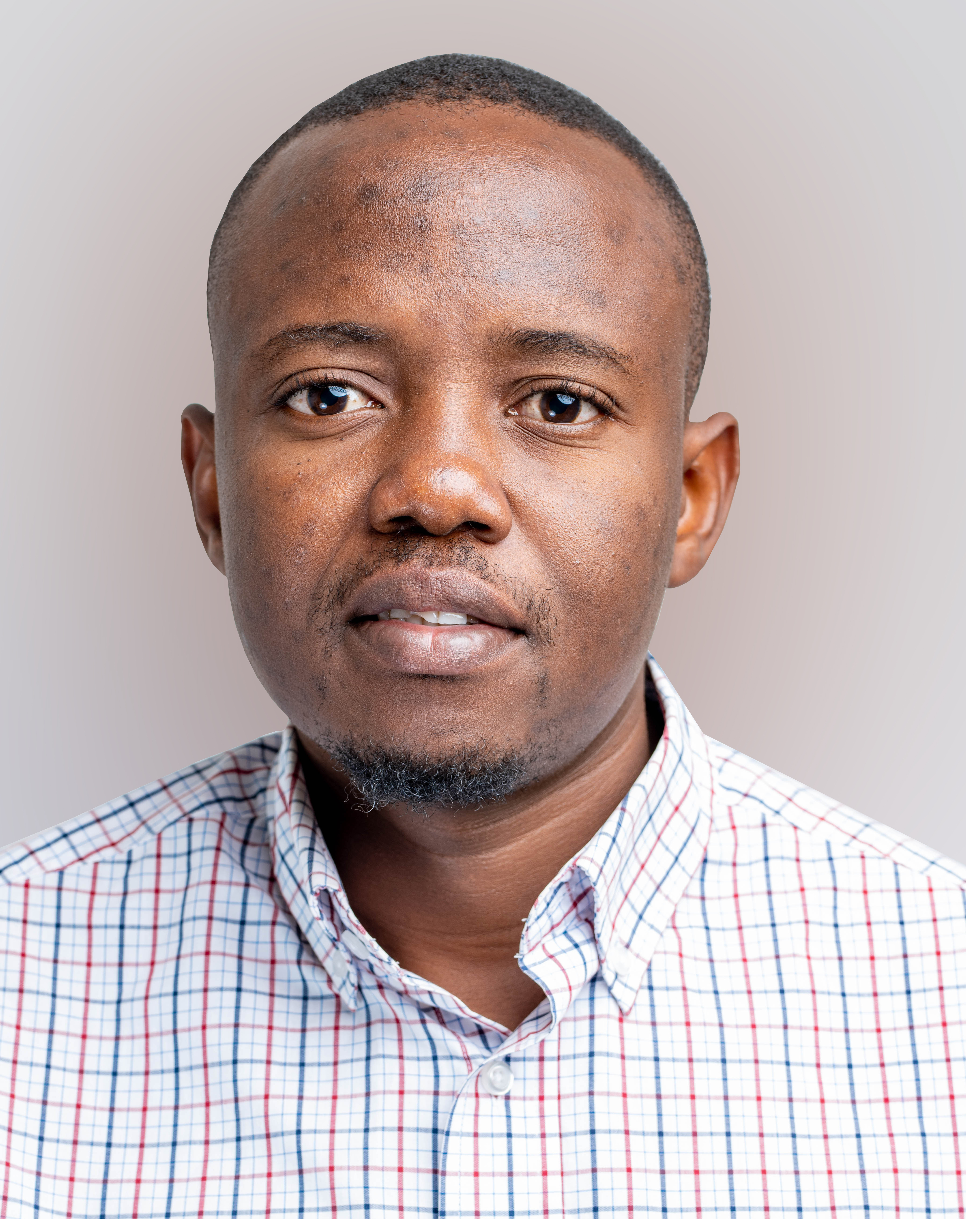
Presenter
Co-Founder & CE0
Dr Michael Mollel, Co-Founder and CEO of Sartify LLC, has PhD in Information Communication Science and Engineering from UoG & NM-AIST. Experience in AI, ML, and Wireless communications. Senior Researcher at the University of Glasgow. Received multiple awards - PhD Research Award from NM-AIST (2020), IEEE WCNC Best Paper Award (2019), and the best AI Use Case ITU Geneva (2024). Email: michael.mollel@sartify.com

Slide 3
Overview of the Presentation
About Sartify
Why Afrocentric AI
Use Cases
LLM
Code

Slide 4
About Sartify
About Sartify LLC
A deep AI technology company specializing in consultation, research, and AI-powered products
Delivers customized AI decision-making solutions for enterprises and consumers
Helps clients enhance customer experience, increase efficiency, reduce costs, boost revenue, and drive exponential growth
Offerings
Custom ML/AI Engineering (Computer Vision, NLP, Recommender Systems, etc.)
Advanced Data Analytics (Business Insights, Predictive Modeling, BI Dashboards)
Data & AI Strategy Consultation (Data Governance, AI Roadmap, Change Management)
AI Executive Training (Workshops, Business Opportunities, Talent Acquisition)

Slide 5
About Sartify
Some of our works
Resume Parsing & Jobs Recommendations .
Customer’s Assistant ChatBot - Chatbot.
Semantic Powered Search Feature & Products List Personalization.
Some on progress works
Docipro: Intelligent Document Processing Autopilot.
Fotopic: AI-powered photographic App.
Resuma Platform: Brainstorm, Craft Profesional CV
Some of Research
Open source various Swahili AI systems
AviLaMa: African Vision-Languages Pre-Training Model.
African Languages Datasets to power various AI research & development in Africa.
Reach Us
www.sartify.com
https://www.sartify.com/contact-us
info@sartify.com
Notes:
Enterprise Custom Solutions:
Resume Parsing & Jobs Recommendations, Niajiri Platform Limited.
Customer’s Assistant ChatBot, AwamuPay.
iPFGPT - RAG Based System For iPF Softwares, iPF SOftwares.
Semantic Powered Search Feature & Products List Personalization, Biashara Plus Limited.
Research:
Open Source various Fine-tuned LLM for Swahili Language Example. Swahili Gemma, Llama, Mixtral etc.
AviLaMa : African Vision-Languages Pre-Training Model. [Learn Visual Concepts Directly From African Language Supervision, A work towards zero shot image retrieval and ranking tasks, zero image classification, visual QA & Conversational AI, Art & Image generation guiding & condition task, text image analysis and content moderation all done in our African Languages. ]
African Languages Datasets to power various LLM research & development in Africa.
A Cassava Categorization Way (Detection & Classification) with AI.
Swahili LLM Evaluation Benchmark Platform.
Our Current In-House Developing Products: Welcome to Join a Waitlist.
Docipro : Intelligent Document Processing Autopilot, a way to uncover valuable insights effortless from any unstructured data within complex manual business workflow- Powered by AI.
Fotopic : AI-powered photographic App. Instantly get quality photographic pictures for your single phone-taken photo. This cover different variations, lookings environment, clothes etc…
Resuma Platfrom : Brainstorm, Craft Profesional CV & Get your desired Job Instantly, all powered by AI (Docipro & Conversional AI).

Slide 6
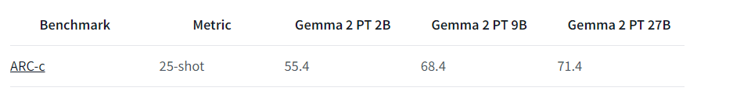
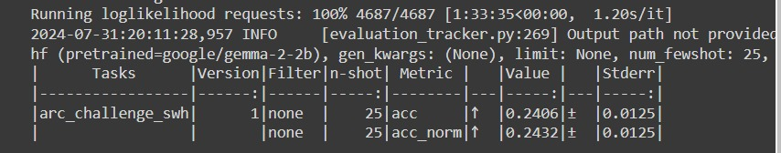
Why Afrocentric AI
Large Language Models (LLMs) like GPT have revolutionized natural language processing (NLP) capabilities. However, these models are typically closed-weight, meaning their weights are not publicly accessible.
Solution Open-weight models, on the other hand, offer transparency but often struggle with low-resource languages
Gemma -2 - 2B

Slide 7
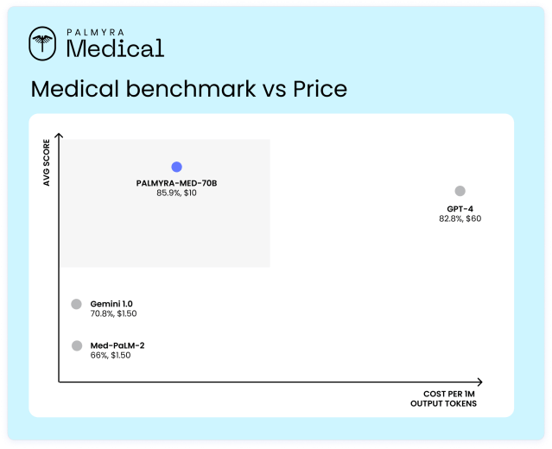
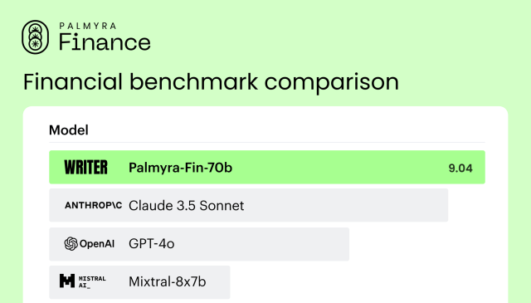
Why Afrocentric
Open/Closed-weight struggle also with Domain-specific and Task-specific LLMs

Slide 8
Use Cases
Small Business Support: LLMs can handle customer inquiries, resolve issues, and provide information, reducing the need for human agents.
Education: Offering customized learning experiences, answering student queries, and providing assignment feedback.
Public Services: Providing accurate and timely information to the public on government services, policies, and announcements.
Health: Assisting doctors by analyzing patient data, suggesting possible diagnoses, and recommending treatment options.
Law: Analyzing case law, statutes, and legal documents to assist lawyers in preparing cases.

Slide 9
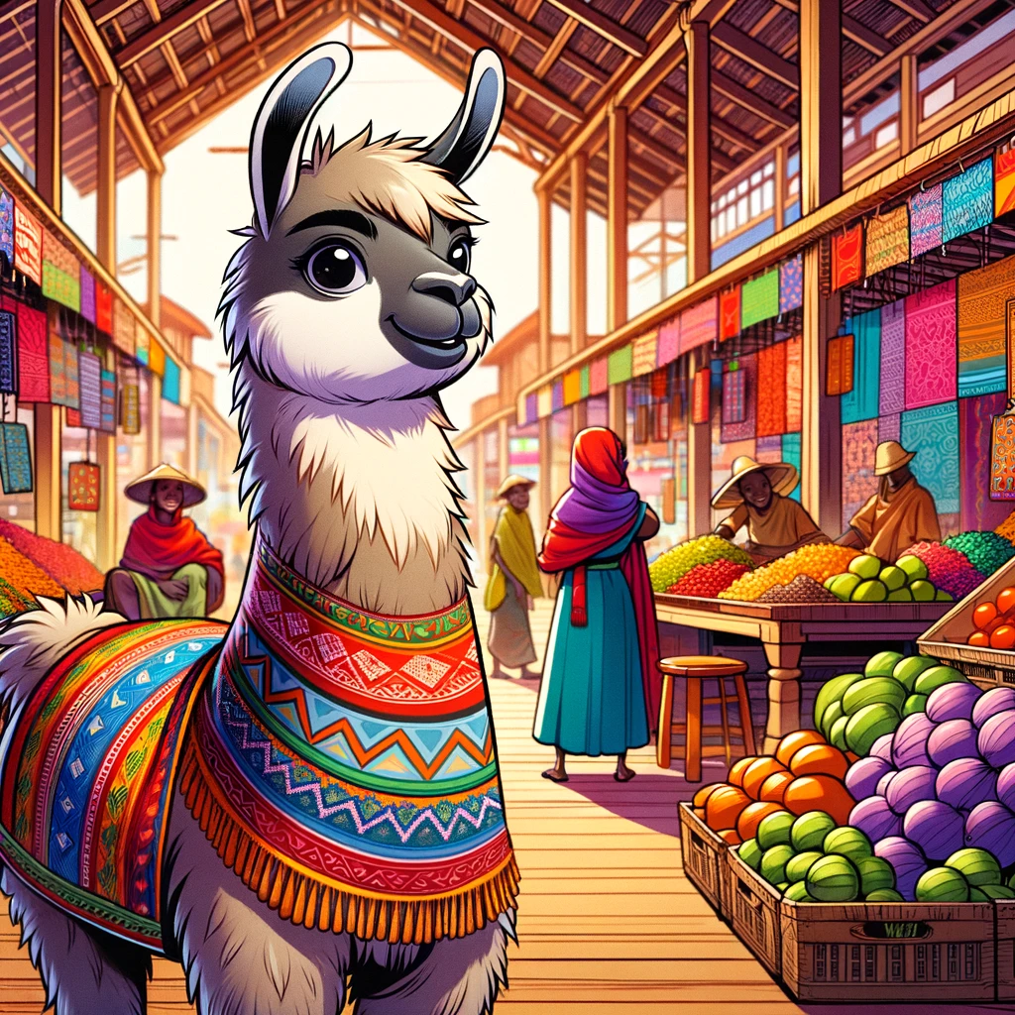
Technical Part of LLM
Prompting and RAG are equivalent to feature engineering (data augmentation, to be exact) in the traditional ML paradigm while finetuning and pretraining are equivalent to model training. So, all three are needed for the best results.
Andriy Burkov
TalentNeuron
Local LLMs
Vocabulary Expansion
Continue the Pretraining Foundation Model
Finetuning for Instruction Following
Finetuning for Model Alignment
Low-Rank Adaptation (LoRA)
Advance Finetuning

Slide 10
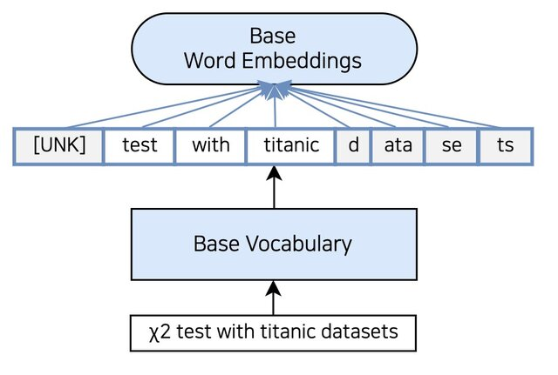
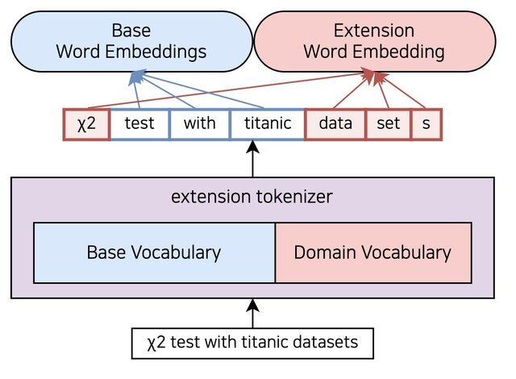
Vocabulary Expansion
Get your text corpus (Dataset approx. more than 1B words)
Train dataset with tokenizer model (LLaMA 2, LLaMA3, Gemma – Sentence Piece Model) link.
Merge the trained tokenizer with the original Foundation model tokenizer by taking the union of vocabularies
Resize LLM's word embeddings and language model head for the new merged vocabulary size
Swahili
Test with Swahili datasets
Swahili
Test with Swahili datasets

Slide 11
Vocabulary Expansion
Get your text corpus (Dataset approx. more than 1B words)
Train dataset with tokenizer model (LLaMA 2, LLaMA3, Gemma – Sentence Piece Model) link.
Merge the trained tokenizer with the original Foundation model tokenizer by taking the union of vocabularies
Resize LLM’s word embeddings and language model head for the new merged vocabulary size
Resized Word Embeddings
Swahili
Test with Swahili datasets

Slide 12
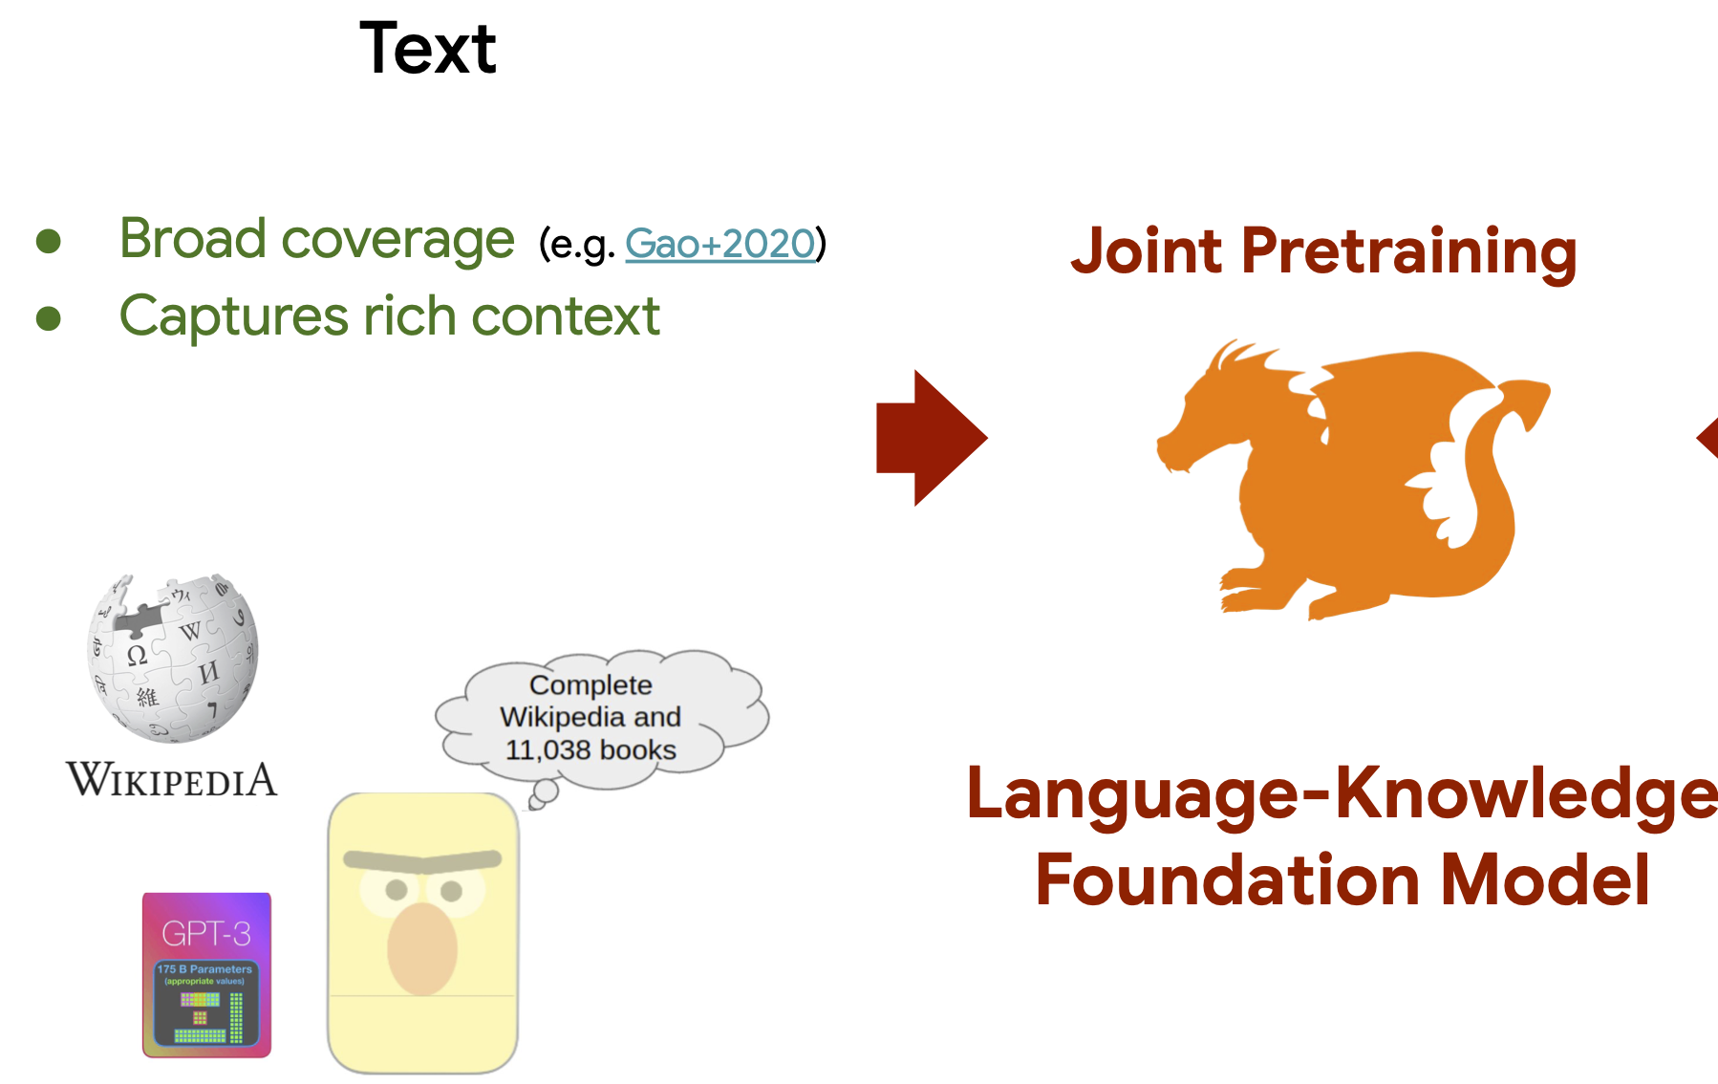
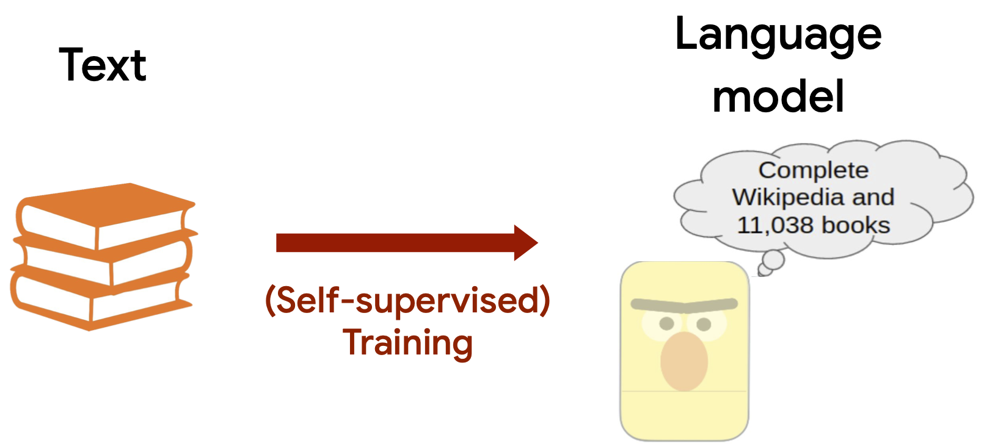

Continue the Pretraining
Initialize model with original Foundation model weights
Pretrain on Dataset corpus using Causal Language Modeling (CLM) as an objective
Apply Low-Rank Adaptation (LoRA) for efficient

Slide 13
Finetuning for Instruction Following
Collect instruction-following data
Use prompt template:
c) Finetune LLM on instruction data with supervised learning
d) Calculate loss only on the {Majibu} part of the sequence
e) Apply LoRA for efficient finetuning
### Maelezo:
{Maelezo}
### Majibu:
{Jibu}
### Instruction:
{Context}
### Answer:
{Answer}

Slide 14

Links
https://github.com/Sartify/JasiriAI_Afrocentric
https://github.com/msamwelmollel/jasiri_presentation

